Slide 1



Google Analytics
View in Power BI
Last data refresh:
7/2/2024 11:08:25 PM UTC
Downloaded at:
7/6/2024 8:03:13 PM UTC

Slide 2
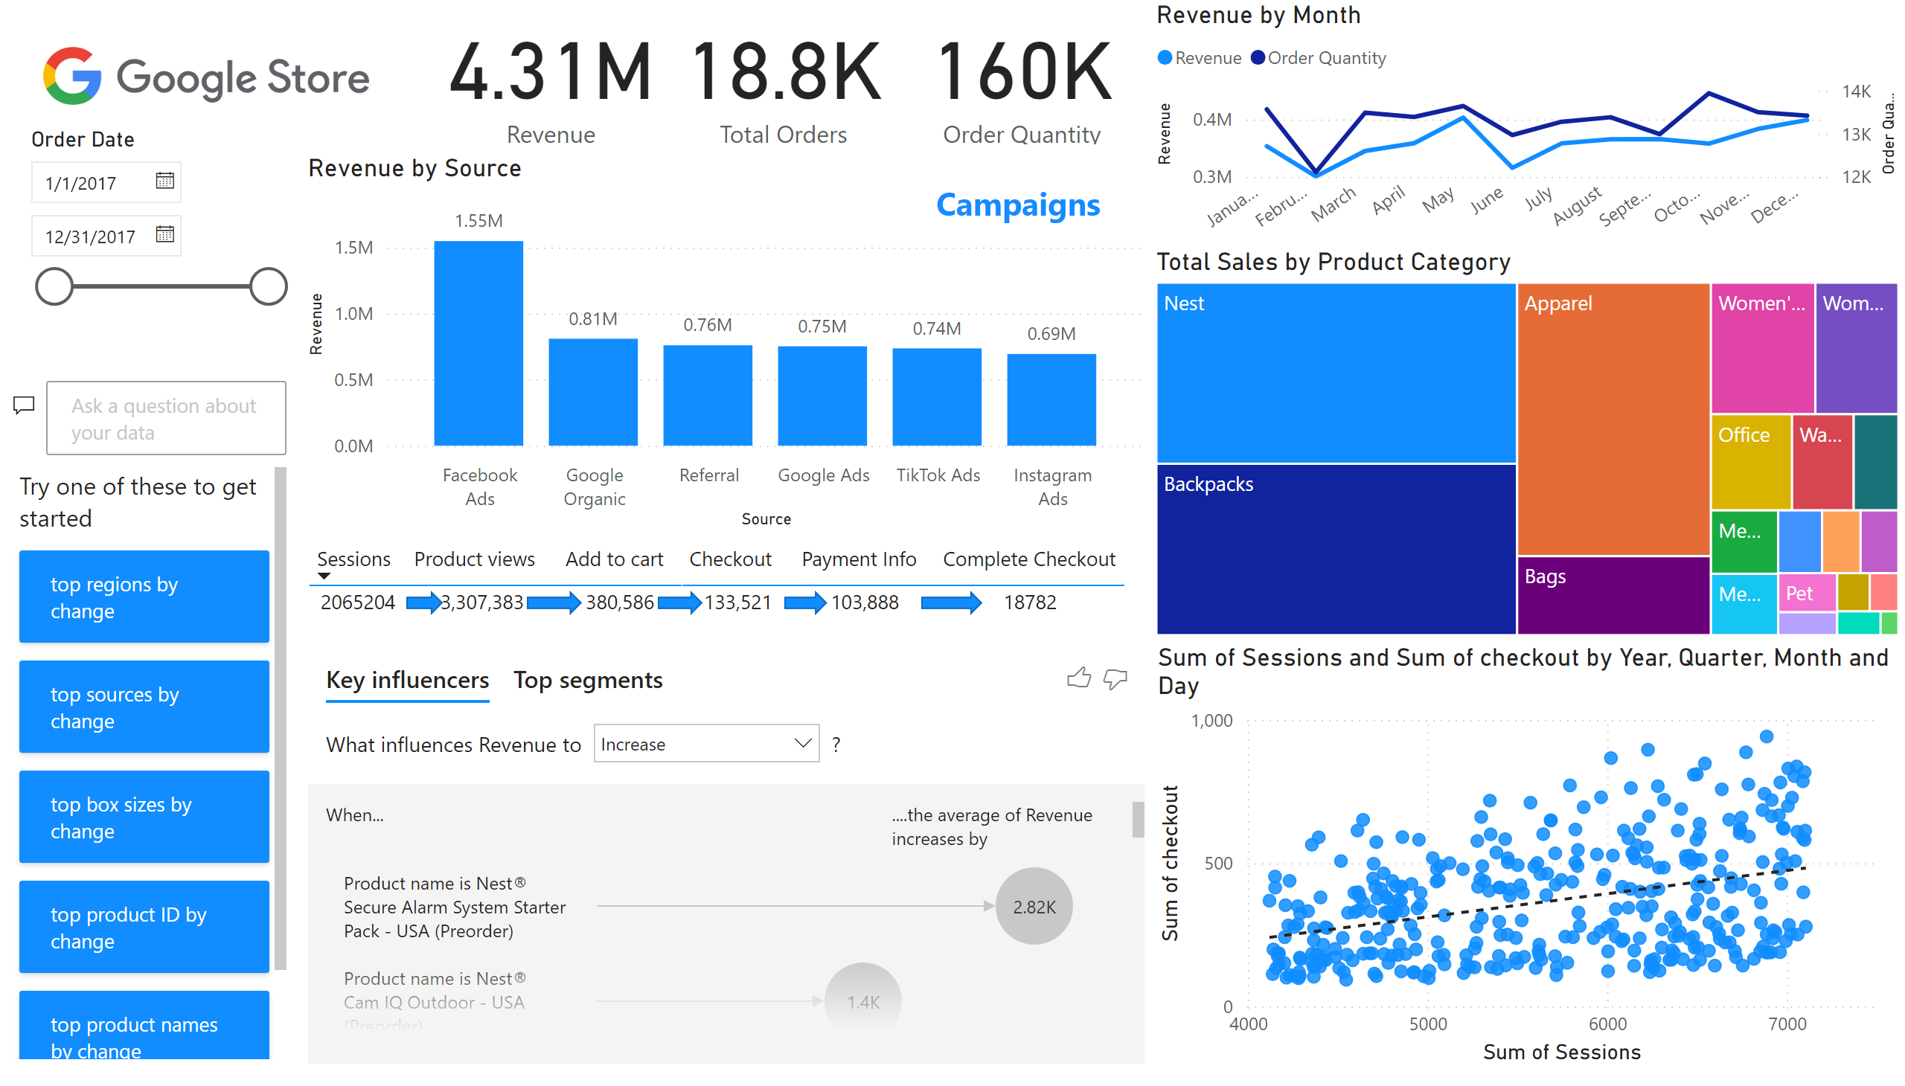
Page 1
Notes:
keyDriversVisual
No alt text provided
qnaVisual
No alt text provided
shape
No alt text provided
shape
No alt text provided
shape
No alt text provided
shape
No alt text provided
shape
No alt text provided
image
No alt text provided
card
No alt text provided
card
No alt text provided
card
No alt text provided
Revenue by Month
No alt text provided
Revenue by Source
No alt text provided
textbox
No alt text provided
tableEx
No alt text provided
treemap
No alt text provided
slicer
No alt text provided
scatterChart
No alt text provided

